Slide 1
The Art of the Desktop
Simon Lees
Simotek
sflees@suse.de / simon@simotek. net
Simotek on Freenode.net / Discord
@Simotek_Dot_Net

Slide 2
About Me
From Adelaide Australia
Using Linux since 2003
Using openSUSE since 2011
openSUSE Contributor for 8 years
Worked at SUSE for 3.5 years
Notes:
I’ve always enjoyed customising
First remember windows 95 or 98 adding html to my home directory
The ability to customize everything has always been something that's attracted me to Linux.
Started modifying themes 10 years ago
This has always lead me to think about User Interfaces as a modern form of art. Which in part is what has lead to this talk.

Slide 3
Form Vs Function
Notes:
Will be a thread through this talk

Slide 4
90’s
Notes:
Siggraph
80’s graphics demo groups
Comodore 64 demo - https://www.youtube.com/watch?v=Jx2w9Wd4g4Q
These weren’t really interactive user interfaces yet so for the purpose of time I’ll skip over them in this talk
Raster Video game UI

Slide 5
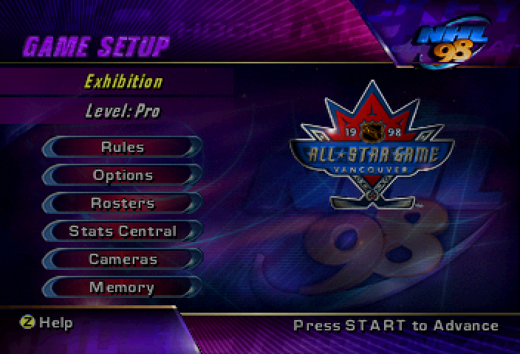
It’s ok to say No or I don’t have time
Notes:
As I was saying we all have a limited capacity, its almost always better to do a few things well then lots of things not well.
If your like me then this often means making hard choices about which projects you invest your time into.

Slide 6
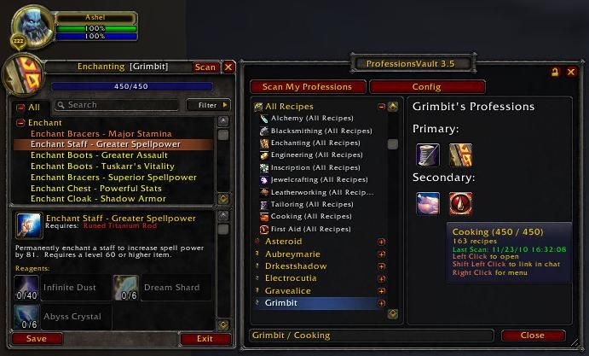
It’s ok to say No or I don’t have time
Notes:
As I was saying we all have a limited capacity, its almost always better to do a few things well then lots of things not well.
If your like me then this often means making hard choices about which projects you invest your time into.

Slide 7
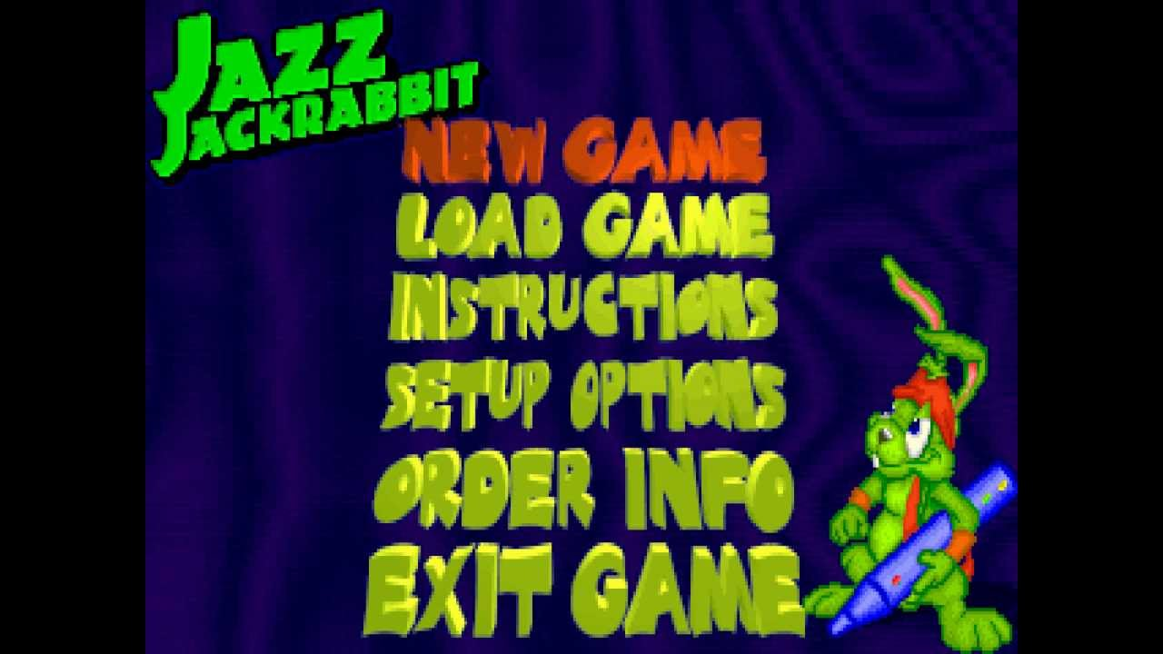
It’s ok to say No or I don’t have time
Notes:
As I was saying we all have a limited capacity, its almost always better to do a few things well then lots of things not well.
If your like me then this often means making hard choices about which projects you invest your time into.

Slide 8
e16
http://themes.effx.us/packages/e16/
Xephyr -br -ac -noreset -screen 1680x1050 :4
env DISPLAY=:4 e16
Notes:
23ozGlass
FinalE
E13
Inferno
Fools of Machines
BS-E
Neuromancer2
Aqua

Slide 9
themes
23ozGlass
FinalE
E13
Inferno
Fools of Machines
BS-E
Neuromancer2
Aqua

Slide 10
00’s
Notes:
Better hardware started to bring some useful, and more importantly some less useful 3d graphics to the desktop.
Theming and skinning continued to evolve as well not just in Linux but in Windows XP and Vista as well.

Slide 11
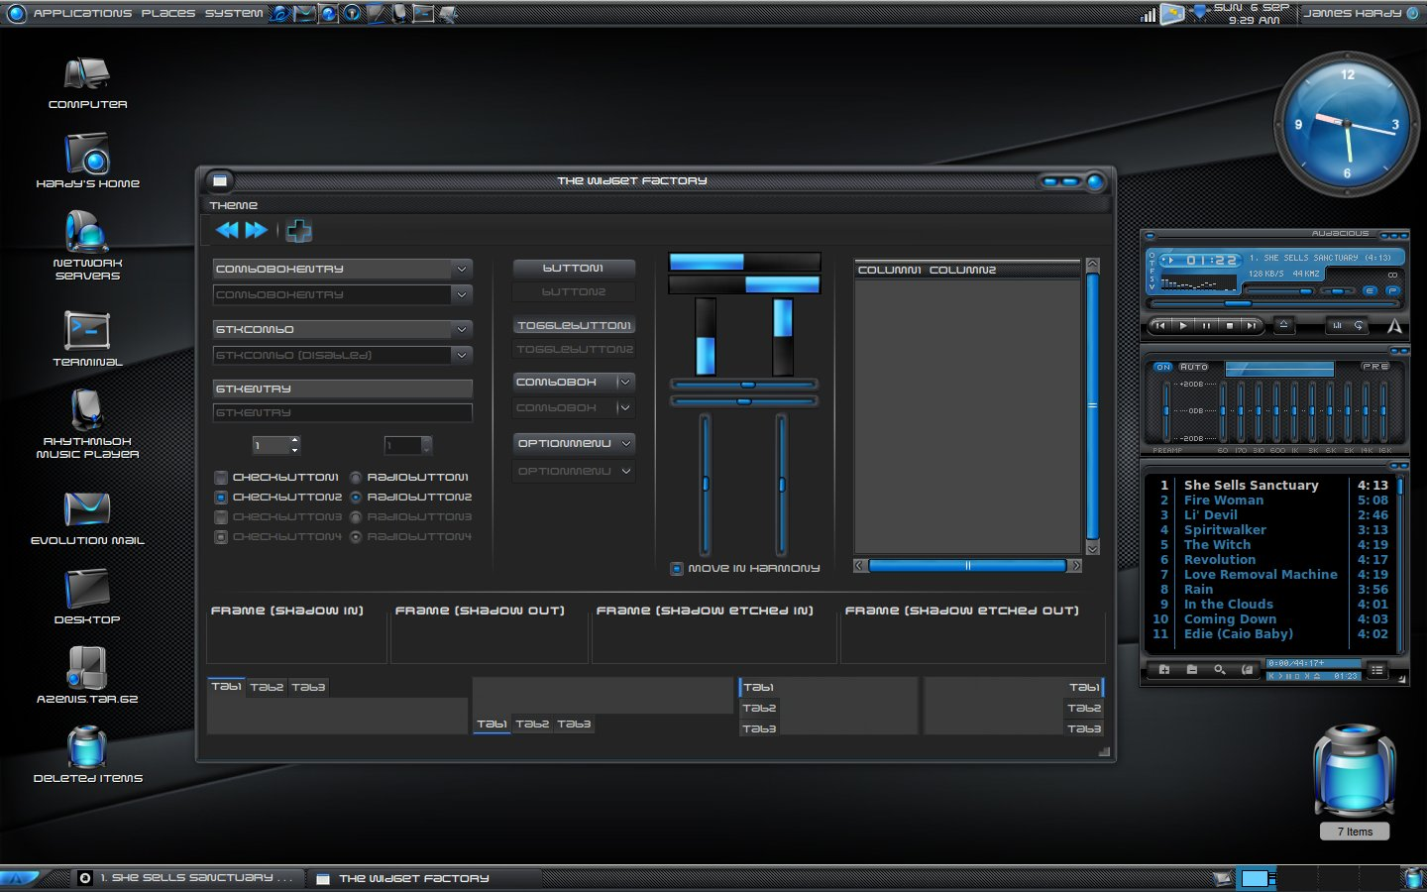
It’s ok to say No or I don’t have time
Notes:
As I was saying we all have a limited capacity, its almost always better to do a few things well then lots of things not well.
If your like me then this often means making hard choices about which projects you invest your time into.

Slide 12
Compiz
Xfce theme https://www.pling.com/p/1330040/

Slide 13
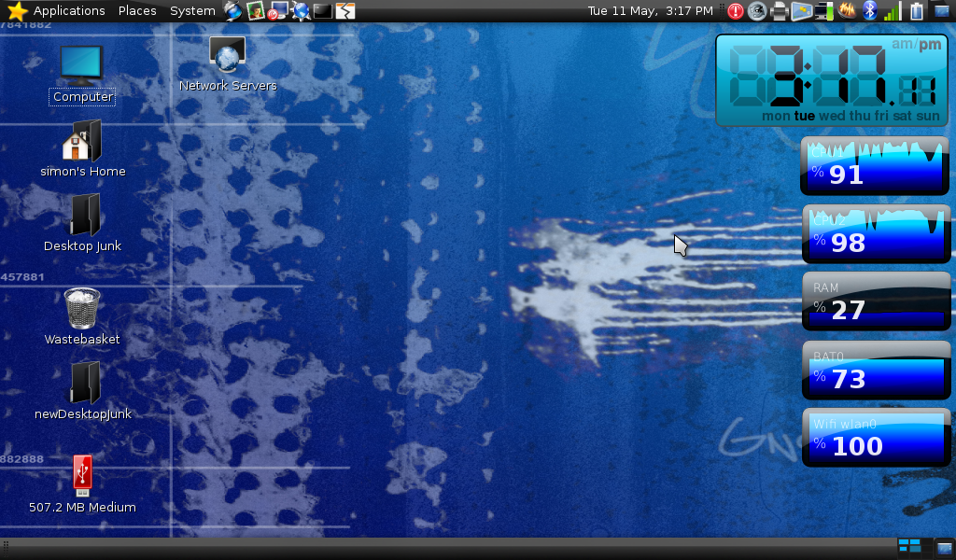
Look after yourself
Everyone has a limited capacity
Avoid burnout
Spend time working on fun things.
Are there things you can do to increase your capacity?

Slide 14
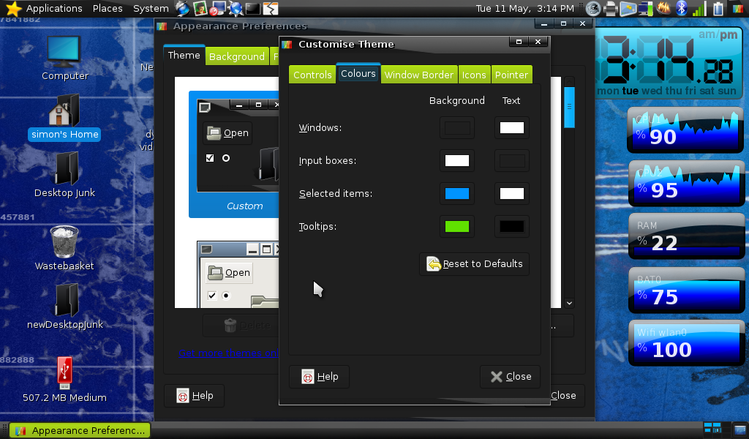
Look after yourself
Everyone has a limited capacity
Avoid burnout
Spend time working on fun things.
Are there things you can do to increase your capacity?

Slide 15
10’s
Notes:
Tablets, Material design things got much simpler and went far more back to function
Still some cool android stuff around CyanogenMod Samsung

Slide 16
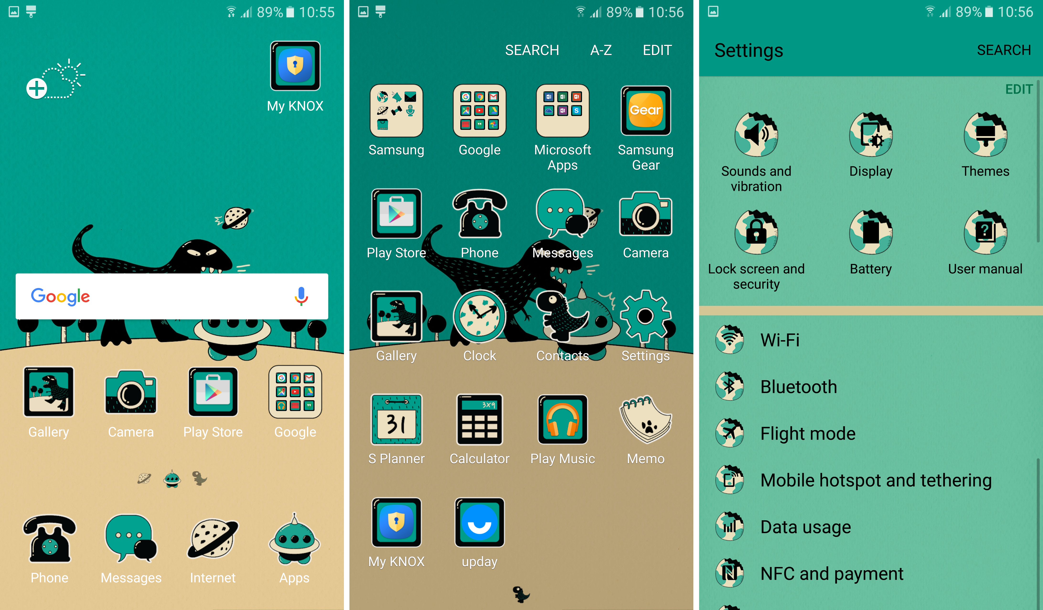
Look after yourself
Everyone has a limited capacity
Avoid burnout
Spend time working on fun things.
Are there things you can do to increase your capacity?

Slide 17
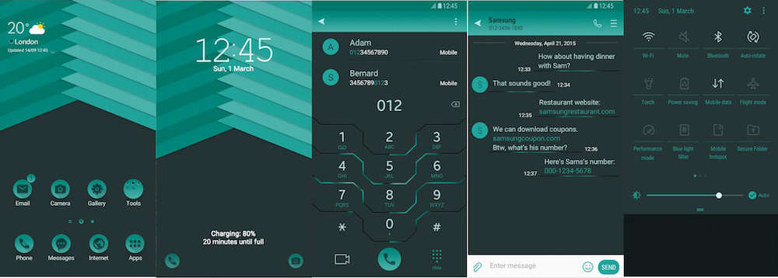
Look after yourself
Everyone has a limited capacity
Avoid burnout
Spend time working on fun things.
Are there things you can do to increase your capacity?

Slide 18
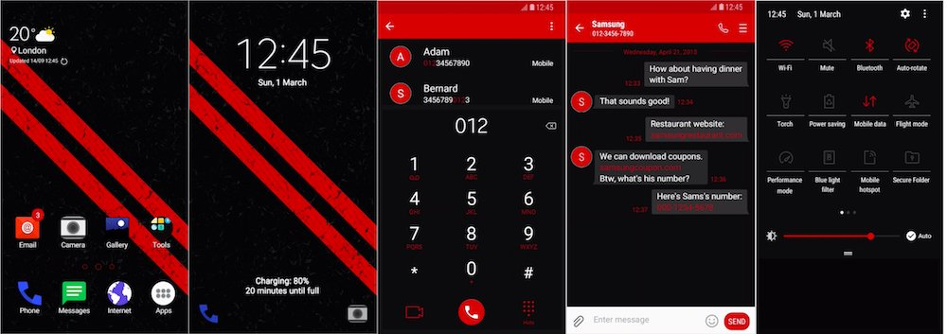
Look after yourself
Everyone has a limited capacity
Avoid burnout
Spend time working on fun things.
Are there things you can do to increase your capacity?

Slide 19
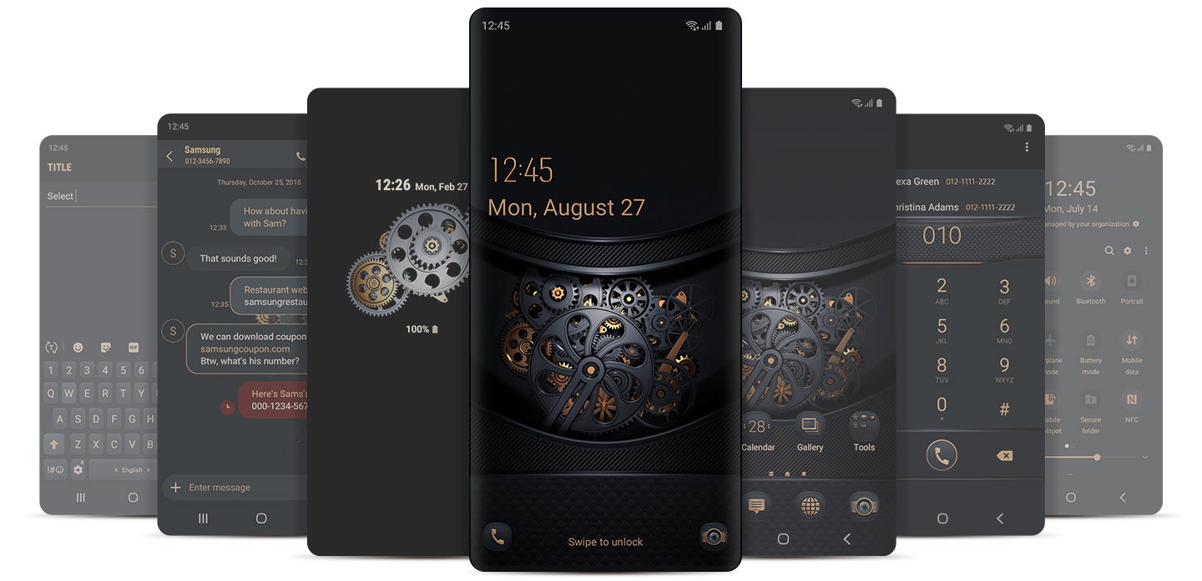
Look after yourself
Everyone has a limited capacity
Avoid burnout
Spend time working on fun things.
Are there things you can do to increase your capacity?

Slide 20
Pop Culture
Notes:
* e16 MIB
* pika
* Hannah Montanna Linux

Slide 21
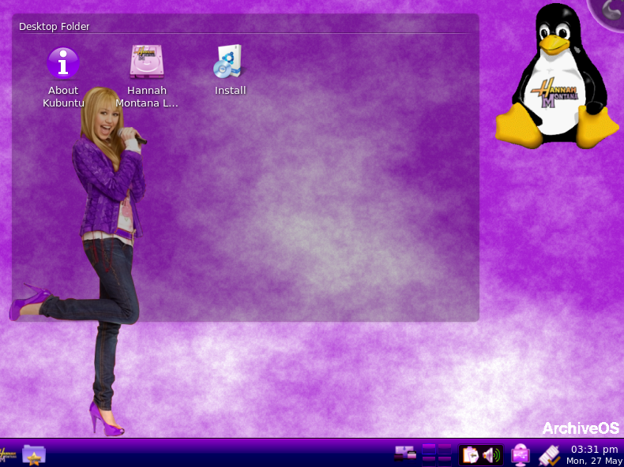
Look after yourself
Everyone has a limited capacity
Avoid burnout
Spend time working on fun things.
Are there things you can do to increase your capacity?

Slide 22
Other applications
Conky – System Monitor
Variety – Wallpaper changer
Notes:
Often programmers have the stereotype of being nerdy introverts who’d rather sit in a basement on there own.

Slide 23
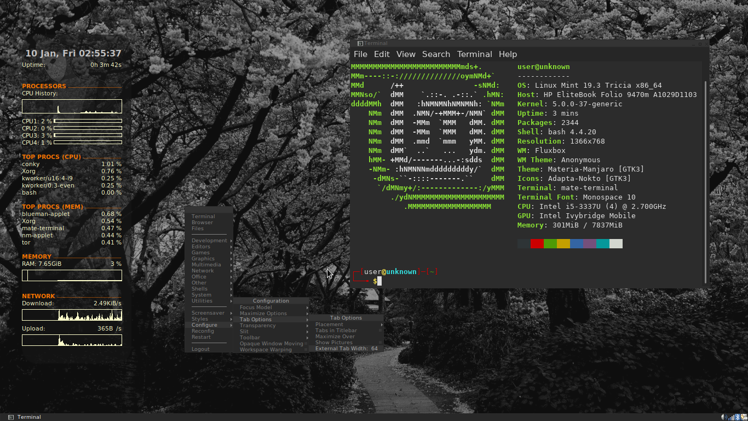

Slide 24
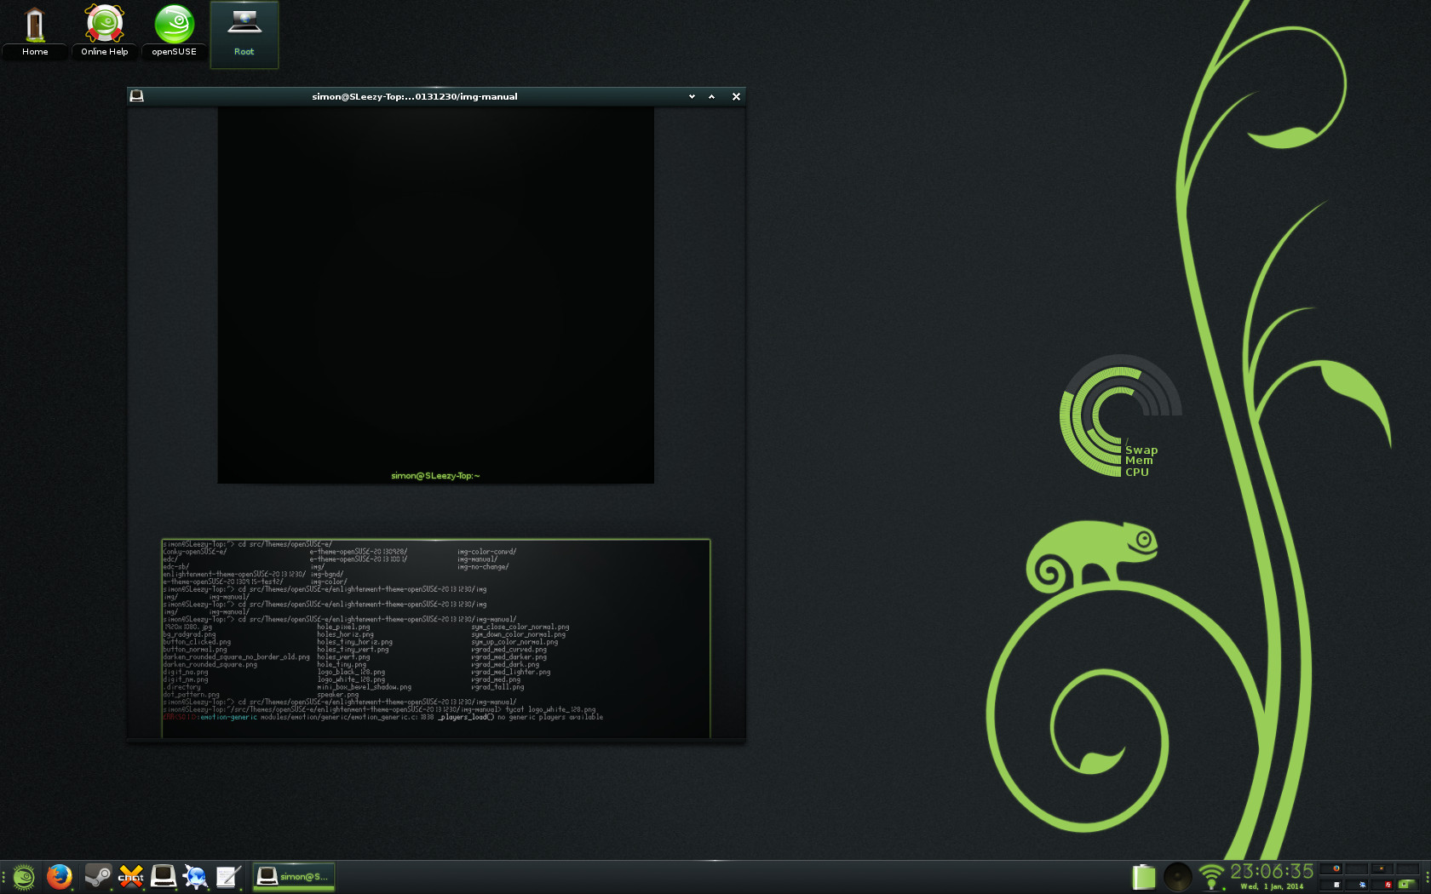

Slide 25
Creating Themes.
Notes:
The more people that are doing what you used to do the more time you have to go and start something else that’s new and fun
It will probably be more work for you in the short term but will likely have some longer term rewards

Slide 26
Qt / KDE
Doing more then changing colors generally requires writing C++
There are some reasonable styles that can be used as a starting point

Slide 27
GTK / Gnome
Images + CSS you can do a fair amount without many issues – Find a theme that’s similar to what you want and start modifying images

Slide 28
Enlightenment / efl
You can do anything / but themes are massive.
Anything includes layout, animation, filters
I’m working to make this better with my vtx set of themes.

Slide 29
Imagemagick
Change the color of a single color image
  convert $F -modulate $BRIGHTNESS,$SATURATION,$HUE ../img-color-convd/$F
Darker / Lighter
  convert $F -channel rgb -brightness-contrast $BRIGHTNESS,$SATURATION +channel ../img-color-convd/$F
Modify alpha
  convert $F -channel A -evaluate Multiply $SHADOW_MULT ../img-color-convd/$F
Notes:
Often programmers have the stereotype of being nerdy introverts who’d rather sit in a basement on there own.

Slide 30
Making things play nice together
Qtstyleplugins-platformtheme-gtk2
QT_QPA_PLATFORMTHEME=gtk2
QT_STYLE_OVERRIDE=gtk2

Slide 31
Creating Themes.
Notes:
The more people that are doing what you used to do the more time you have to go and start something else that’s new and fun
It will probably be more work for you in the short term but will likely have some longer term rewards

Slide 32
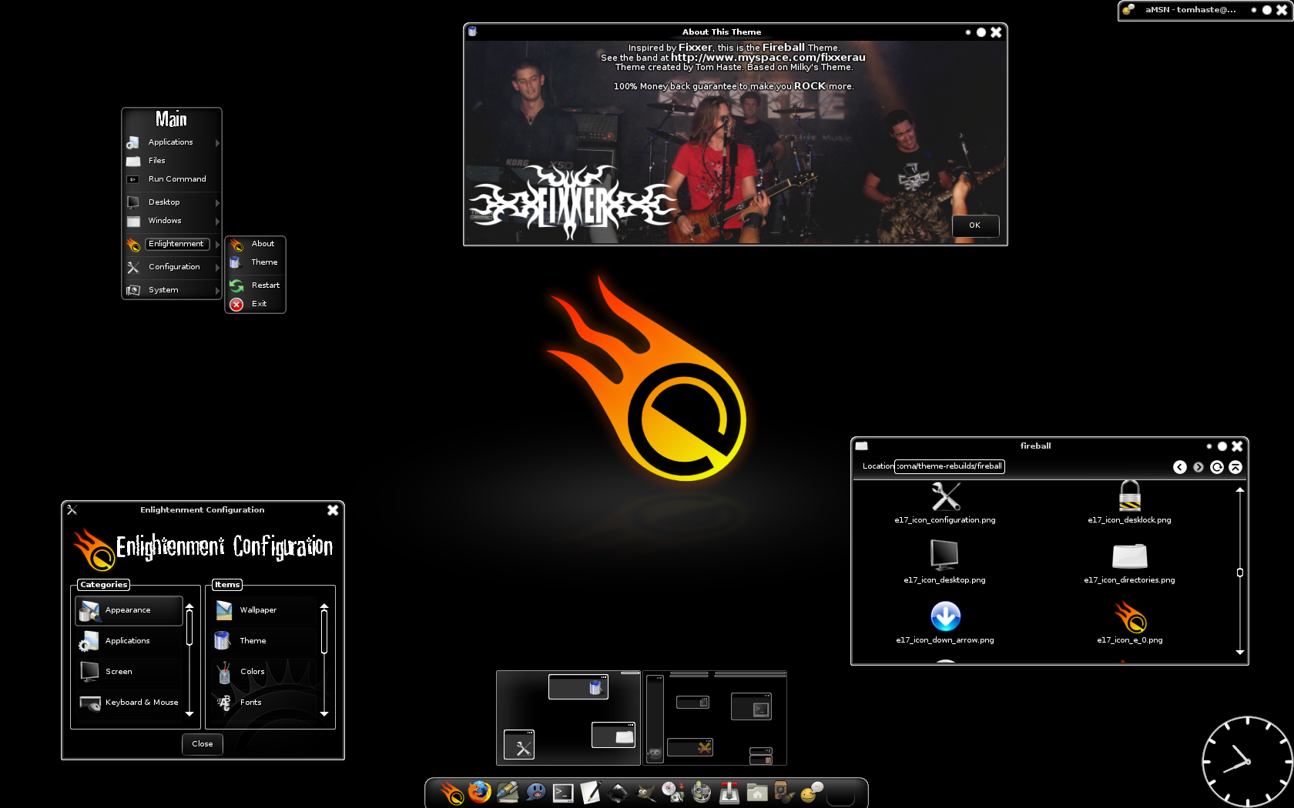
Look after yourself
Everyone has a limited capacity
Avoid burnout
Spend time working on fun things.
Are there things you can do to increase your capacity?
Notes:
Every now and then when I feel like doing some design work I go and make a new enlightenment theme.
If you eat healthier excersize more and sleep better will you have more energy to work on stuff
If you work in a job that involves lots of thinking it will be harder to think in your spare time.

Slide 33
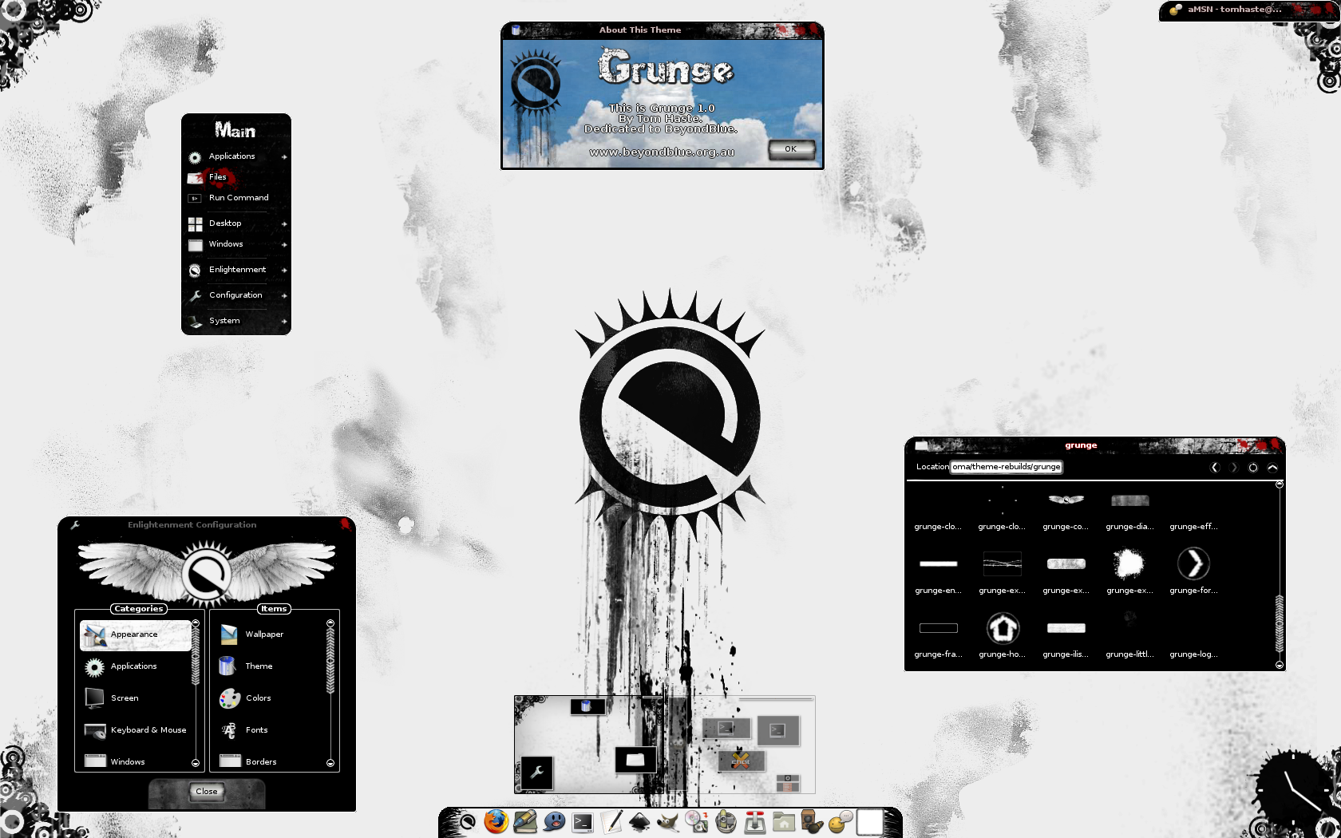
Look after yourself
Everyone has a limited capacity
Avoid burnout
Spend time working on fun things.
Are there things you can do to increase your capacity?
Notes:
Every now and then when I feel like doing some design work I go and make a new enlightenment theme.
If you eat healthier excersize more and sleep better will you have more energy to work on stuff
If you work in a job that involves lots of thinking it will be harder to think in your spare time.

Slide 34
Look after yourself
Everyone has a limited capacity
Avoid burnout
Spend time working on fun things.
Are there things you can do to increase your capacity?
Notes:
Every now and then when I feel like doing some design work I go and make a new enlightenment theme.
If you eat healthier excersize more and sleep better will you have more energy to work on stuff
If you work in a job that involves lots of thinking it will be harder to think in your spare time.

Slide 35
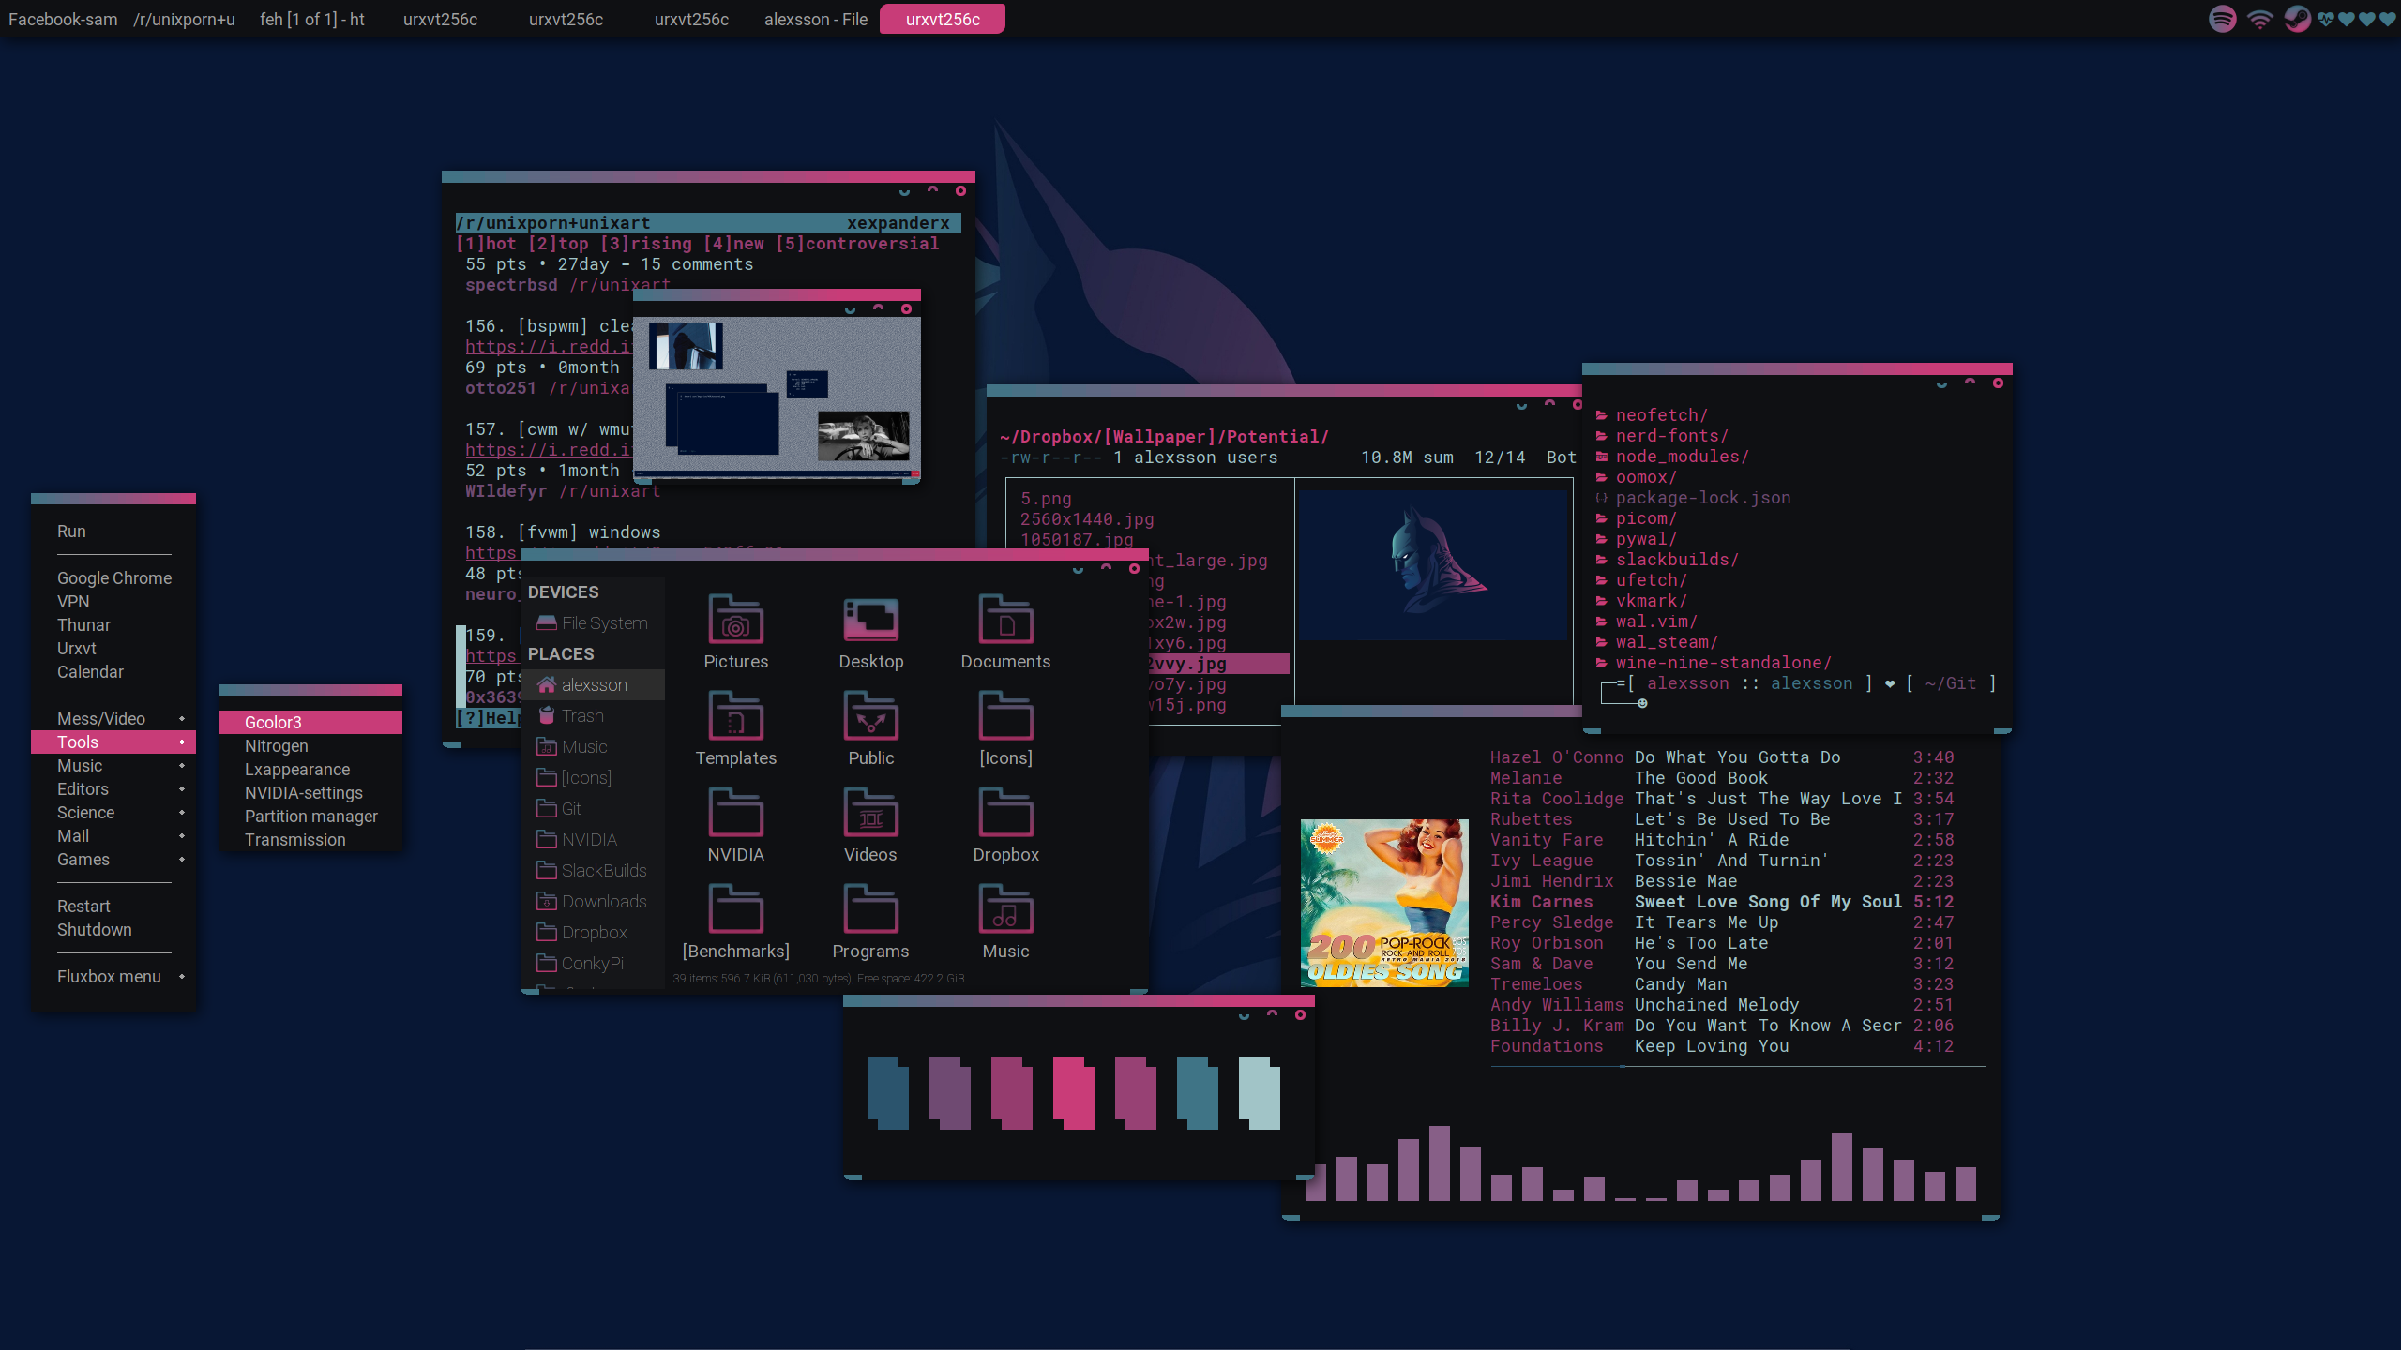
https://www.reddit.com/r/unixporn/comments/e1ok0k/fluxbox_old_songs/

Slide 36
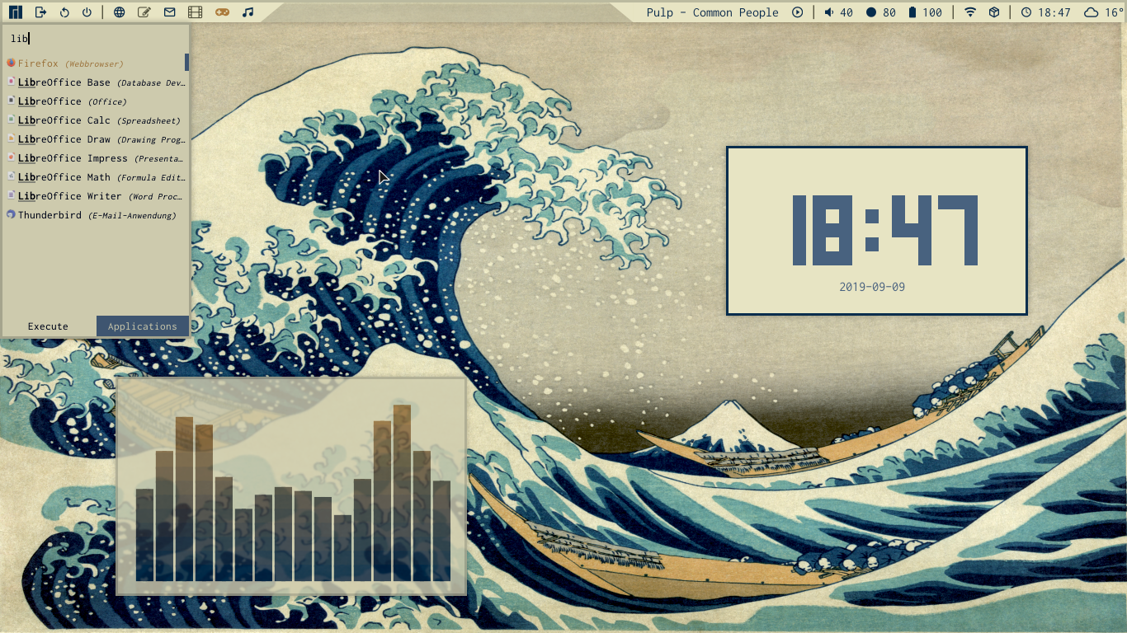
https://www.reddit.com/r/unixporn/comments/e1ok0k/fluxbox_old_songs/

Slide 37
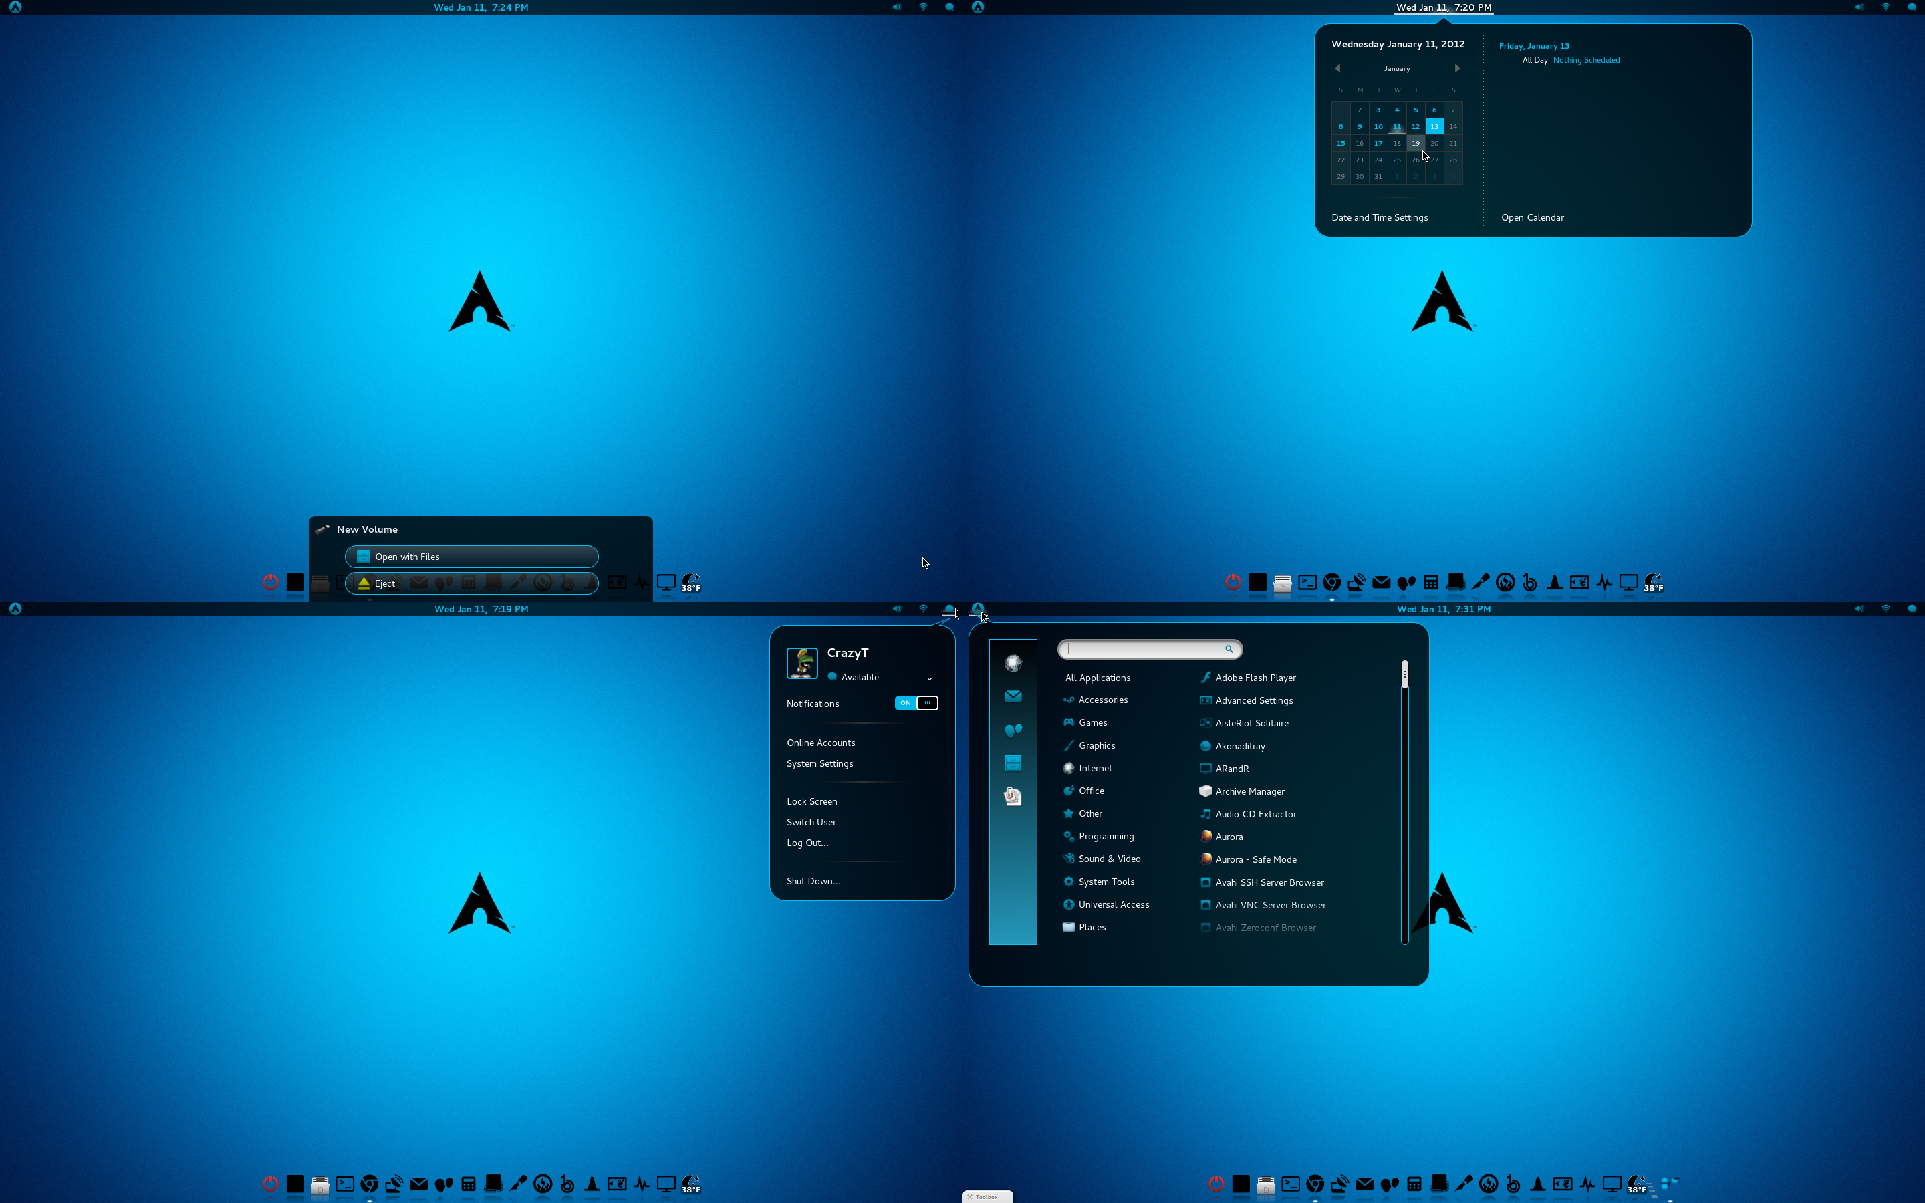

Slide 38
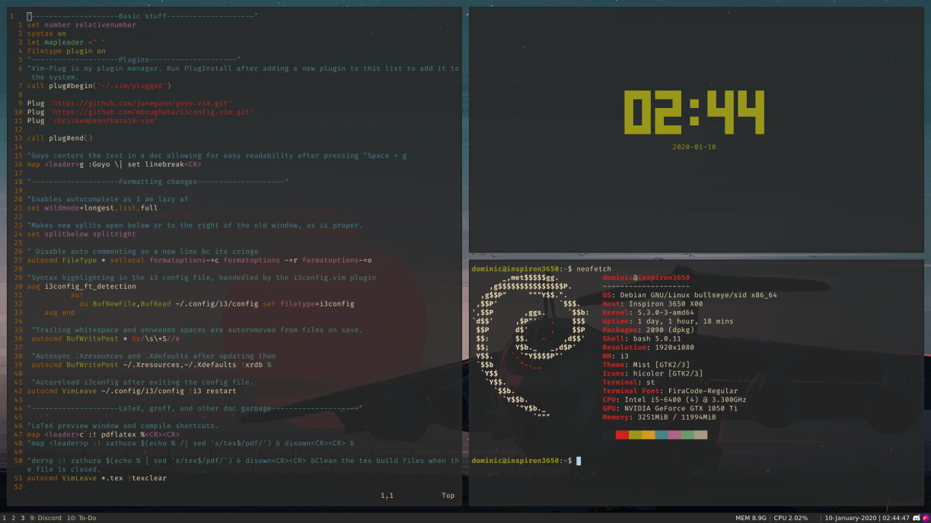

Slide 39
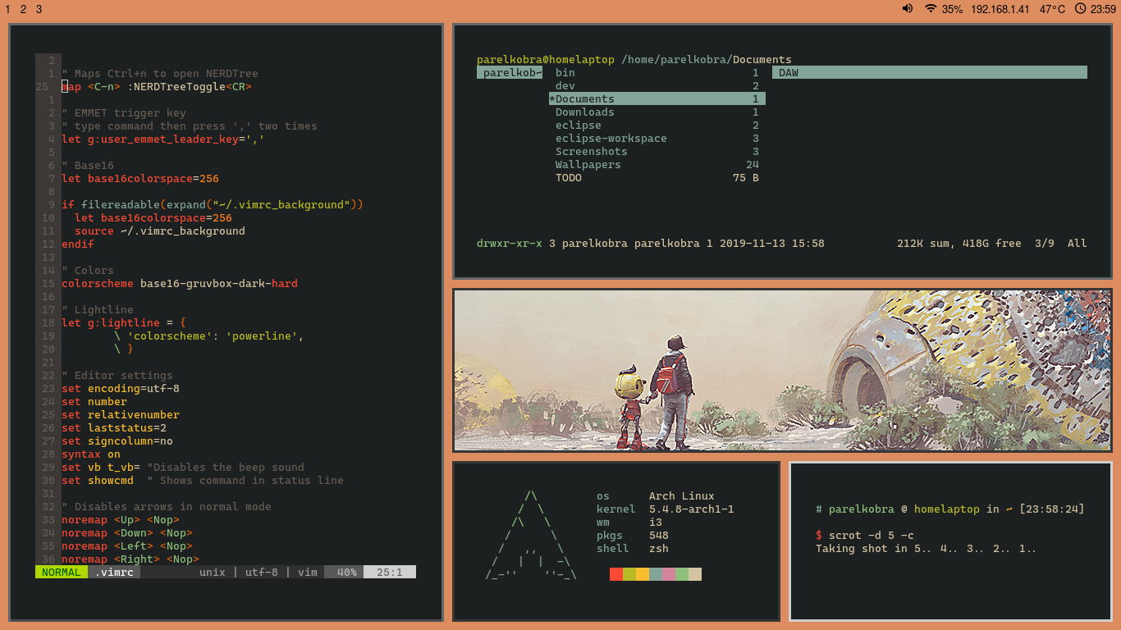
https://www.reddit.com/r/unixporn/comments/em10h7/i3_school_laptop/

Slide 40
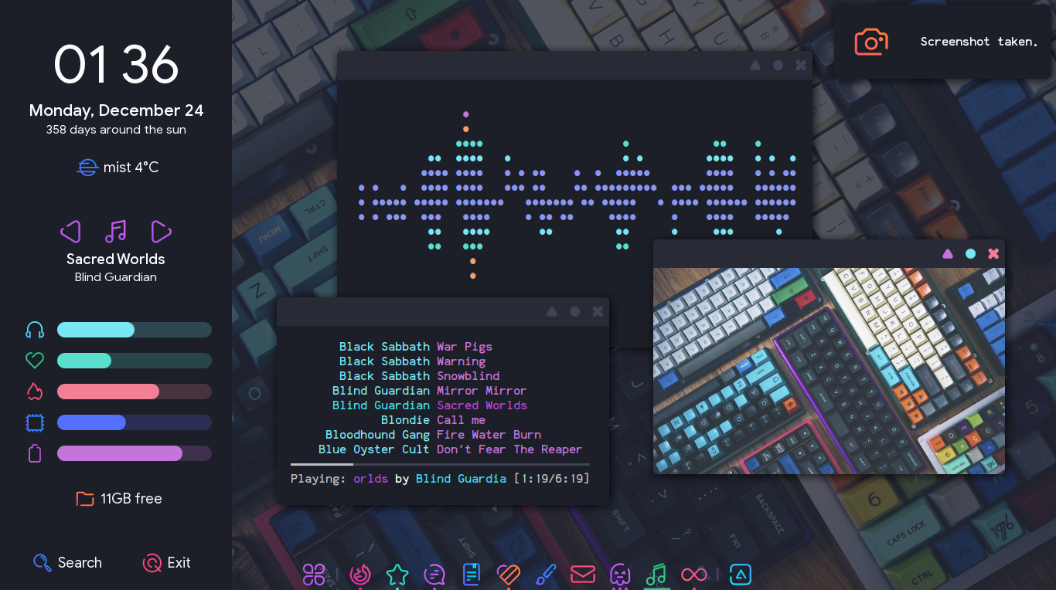
https://www.reddit.com/r/unixporn/comments/a900p7/awesome_mechanical_love/

